Slide 1
TEAM KENAKO

Slide 2
Team Introduction
Thabang Khuzwayo | Anashrie Naidoo | Polly Nortje | Ebrahim Hasrod | Mohamed Dewan | Amit Gopal

Slide 3
SMALL BUSINESS DEVELOPMENT IN RETAIL AND HOW TO GET IT RIGHT

Slide 4
Situation
The Situation from a Small Supplier Perspective
One hat for all
No financial expertise
Too many regularity hurdles
We get bullied all the time

Slide 5
Situation – From a retailer perspective
Poor infrastructure in Supply chain and logistics
Adds costs back to the retailer
Not consistency reliable
Affects delivery quality
Trade term limitations
Shorter payment terms than larger suppliers
Penalties are difficult to be enforced
Rigid framework of how to trade
Not innovative enough (R&D, design, expert staff)
Lack of funding to support marketing and promotion (sell out strategies)
No leveraged economies of scale
Impacts hugely on sourcing strength
Higher product costs

Slide 6
Situation
SMME FROM A MACRO PERSPECTIVE
Small businesses employ 60% of the total workforce
Global benchmark at 70% (75% China)
Small businesses contribute 45% to GDP
Global benchmark at 50%
Small business start-ups have a failure rate of 50% in the first two years
New start-up confidence by individuals nosedived to 14% (2012 Global Entrepreneurial Monitor)

Slide 7
Stakeholders: CURRENT Situation
Small Business
Government
Large retailers
Country objectives.
Push policy from macro perspective
Transformation, job creation, economic policy
Political leverage
Minimal involvement, accountability
Not an influencer
One dimensional perspective
Freedom of lifestyle
Create direct employment
Personal wealth creation
Skills/industry development (e.g. Manufacturing)
Beneficiary
Enforcer
Target

Slide 8
Stakeholders: FUTURE Situation
Small Business
Government
Large retailers
Background role
An involved, participative member
Focus on strength
Incentivises (tax rebates etc.)
Support through budget allocation
Skills development etc.
Innovation
Differentiation
Publicise opportunity to all for small business participation
Willing to engage
Become the ultimate catalyst in creating an enabling environment
Beneficiary
Supportive
Enabler

Slide 9
Situation
Mr Boba More who wishes to see his products listed with by major Wholesalers & Retailers within South Africa.
His challenges, as elaborated in our problem statement with regards to smaller suppliers are:
Funding,
Supply chain,
Skills development and mentorship, which are the bases of our argument.

Slide 10
Concern
The Small business mandate for better integration
within retail is largely dependent on the practical enabling environment, by small business
capability as well as big business participation.

Slide 11
Question
How could large Wholesalers & Retailers
contribute to the sustainable growth of
Small Suppliers?

Slide 12
Answer
Large Wholesalers & Retailers
can contribute to the sustainable growth
of small suppliers
by creating an enabling environment!
Funding
Skills Development
Supply Chain
Notes:
Anashrie

Slide 13
Reasoning
Early payment terms
Exclude Listing Fees
Flexible supplier trading terms
Improved cash flows
Removes barriers to entry
“On shelf prices” more market related
Assist fronting capital
Purchasing raw materials & equipment
Funding
Notes:
Anashrie

Slide 14
Reasoning
Warehouse sharing
Backhauling
Technology platforms
Assist with pre-sort facilities
Inventory collection on return trips back
Access to systems
Leveraging Supply Chain
Notes:
Anashrie

Slide 15
Reasoning
Rigorous Training
Financial acumen
Understanding NB of market research
Mentorship Programmes
Developing strengths & Overcoming weaknesses
Opportunity for new skills and knowledge
New ideas & ways of thinking
Business & marketing plan
Skills Development
Notes:
Anashrie

Slide 16
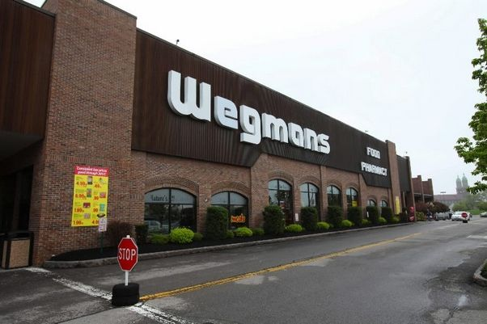
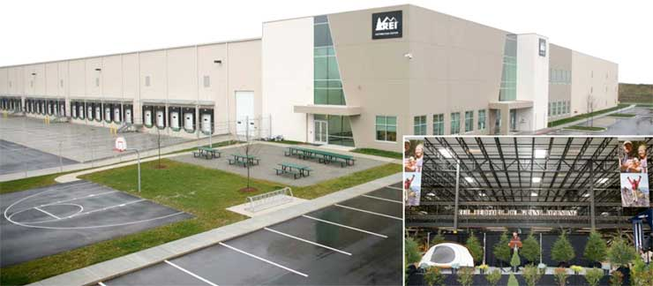
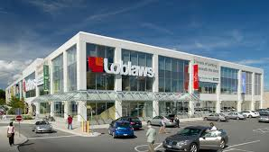
Reasoning
Supply Chain
Skills Development
Funding
Notes:
Thabang

Slide 17
Reasoning What is in it for Retailers?
Good Corporate Governance
Wider Product base
Improved BBBEE rating
Leverage Negotiation
Customised Orders prevent overstocking
Retailers
Notes:
Thabang

Slide 18
Evaluation
In conclusion and in reference to our answer, “Large Wholesalers & Retailers can contribute to the sustainable growth of small suppliers by creating an enabling environment,” will assist with:
.
Funding
Supply Chain
Skills Development

Slide 19
Evaluation
Funding
Large Wholesalers & Retailers must assist Smaller Suppliers
Early payment
Excluding the charging of listing fees removes barriers of entry
Flexible trading terms to offer their products at more reasonable prices, thus increasing their sales
Funding smaller suppliers to purchases raw materials and equipment
Our case study with Mr Boba More is relevant here in all respects and we evaluate our answer accordingly

Slide 20
Evaluation
Relevance to our case study, Mr Boba More:
Will pay him within seven days;
Will not charge any listing fees;
Will be listed without paying rebates;
Will be funded for the procurement of his raw materials and equipment, will go a long way in ensuring Mr Boba’s successful supply of product into mainstream wholesale and retail

Slide 21
Evaluation
Supply Chain
Pick & Pay can now give Mr Boba More access to backhauling, space in their DC’s, and use of their online stock replenishment platforms
This will ensure that Moringa, will now be available to all Pick & Pay stores, consistently and cost effectively

Slide 22
Evaluation
Training & Development
Mr Boba More will become more efficient and effective
He will be able to engage with larger retailers, and remove all inefficiencies of a smaller supplier supplying mainstream retail

Slide 23
The Framework depends on YOU! Thank You!
Notes:
Ebrahim

